Slide 1


COVERED INTEREST RATE PARITY VIOLATIONS AND IMPLICATIONS FOR FINANCIAL INSTITUTIONS
Manish Chalana
Megha Raveendran
Silvi pandey
Gonzalo DE LA ORDEN
AADARSH kUMAR SINGH

Slide 2
Objectives
CIP violations measurement
Why CIP violations matter ?
Recent trends in cross-currency basis and underlying interest rates
How do CIP deviations differ for G10 currencies as opposed to EME ?
Are CIP deviations persistent or predictive ?
Can we identify causal effects of the deviations ?
How many factors are sufficient to explain CIP variations?
How does perceived value of USD affect CIP?
Identify CIP violation trends before and after crisis
Identify and analyze arbitrage opportunities based on CIP deviations.
Explanations for the CIP deviations based on costly financial intermediation.

Slide 3
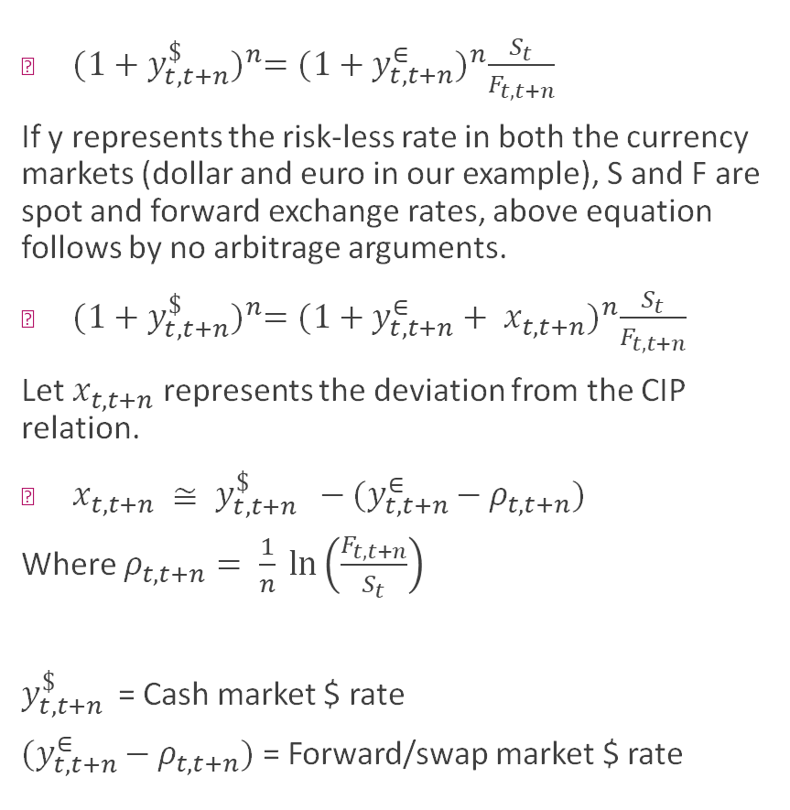
CIP deviations measurement
${(1+y_{t,t+n}^{\$})}^{n}={(1+y_{t, t+n}^{∈})}^{n}\frac{S_{t}}{F_{t, t+n}}$
If y represents the risk-less rate in both the currency markets (dollar and euro in our example), S and F are spot and forward exchange rates, above equation follows by no arbitrage arguments.
${(1+y_{t,t+n}^{\$})}^{n}={(1+y_{t, t+n}^{∈}+ x_{t, t+n})}^{n}\frac{S_{t}}{F_{t, t+n}}$
Let $x_{t,t+n}$ represents the deviation from the CIP relation.
$x_{t, t+n} ≅ y_{t, t+n }^{\$} −{(y}_{t, t+n }^{∈}− ρ_{t, t+n})$
Where $ρ_{t, t+n}= \frac{1}{n} ln\left(\frac{F_{t,t+n}}{S_{t}}\right)$
$y_{t, t+n }^{\$}$ = Cash market $ rate
${(y}_{t, t+n }^{∈}− ρ_{t, t+n})$ = Forward/swap market $ rate

Slide 4
Why CIP deviations matter ?
A significant part of USD denominated assets are held by foreign investors like pensions funds and insurance companies based in Europe and Japan. Therefore, offshore funding is an important tool to hedge the currency risk for these players whose liabilities are marked in their local currency.
CIP deviations measure the state of offshore dollar funding conditions who does not have access to the direct dollar funding. The greater the increased hedging costs for foreign investors, the less will be the demand and, thus, prices of these assets.
Greater the cross-currency basis, the easier it is for the foreign investors to access the FX swap markets and vice versa.

Slide 5
Datasets Used
CIP data for 18 EM and 10 G10 countries (Wenxin Du et al): https://www.dropbox.com/s/2i3zxa1n0m1mj6s/cip_dataset_v2.csv?dl=0
DXY dataset for the same period (Yahoo Finance): https://finance.yahoo.com/quote/DX-Y.NYB/
Bloomberg data for LIBOR rates, xccy basis and FX rates

Slide 6
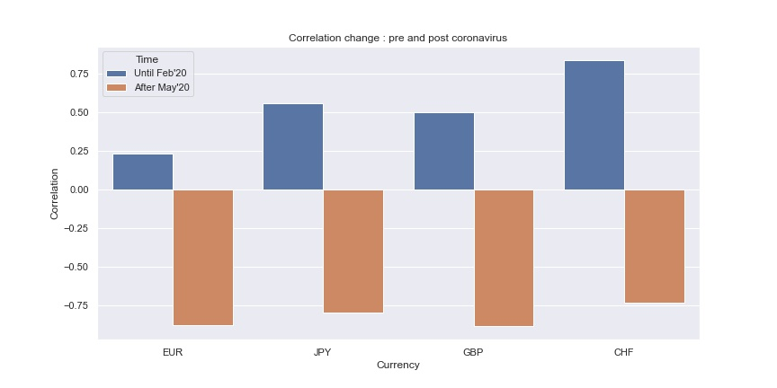
XCCY LIBOR basis vs LIBOR rates
The correlations between LIBOR rates and LIBOR basis were positive pre-COVID and negative post-COVID outburst.

Slide 7
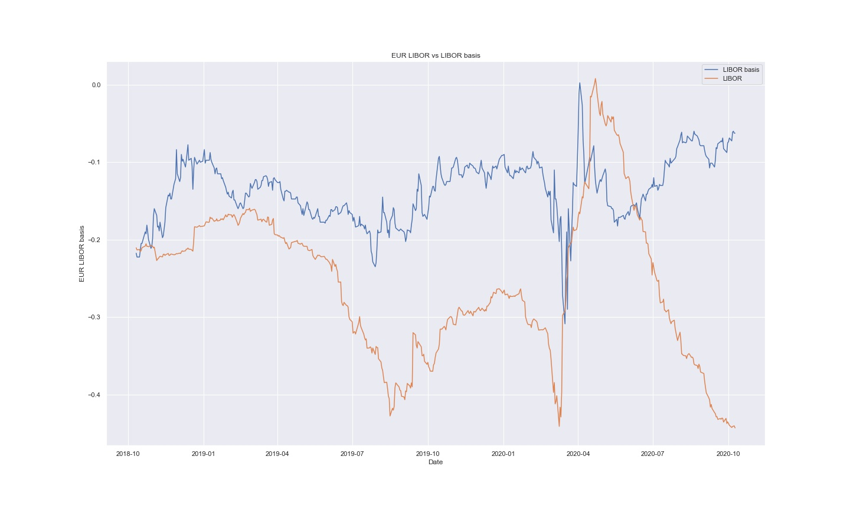
EUR LIBOR basis vs LIBOR rates (1 yr)
Post COVID outbreak, the interest rates have been going down and basis have been going up contrary to the trend seen otherwise.

Slide 8
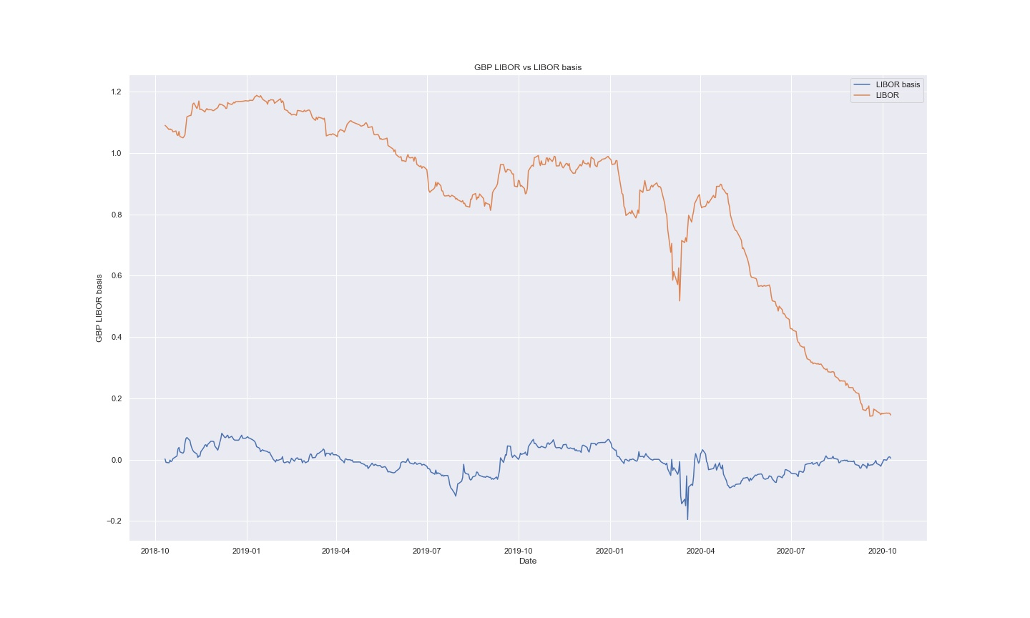
GBP LIBOR basis vs LIBOR rates (1 yr)
Post COVID outbreak, the interest rates have been going down and basis have been going up contrary to the trend seen otherwise.

Slide 9
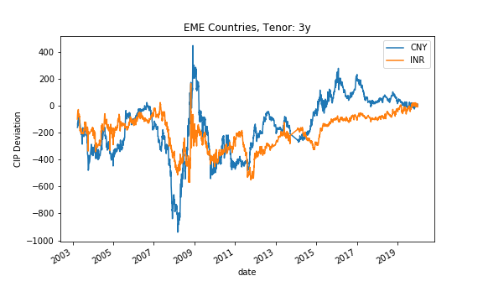
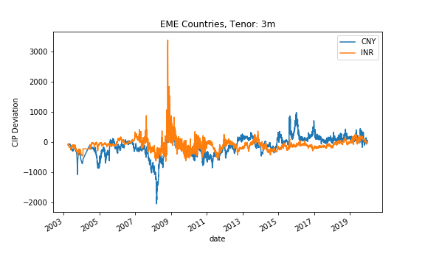
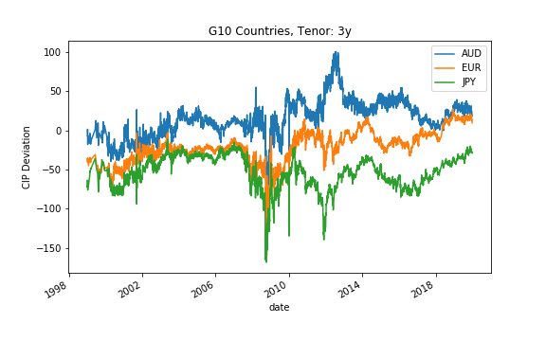
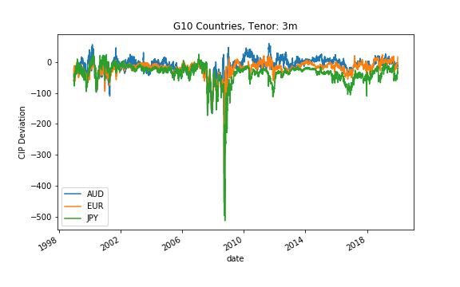
EME VS G10
CIP deviations are more volatile in EME as compared to G10. The standard deviation being ~10 times.
The range of CIP deviations are also ~5-10 times for EME.
For a tenor of 3 years, countries show both positive and negative deviations
For a tenor of 3 months, EME show positive deviations while G10 show negative deviations.
Specifically, we observe that AUD's basis is mostly positive, and JPY's is mostly negative

Slide 10
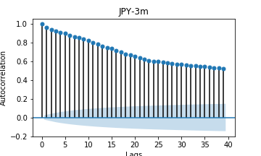
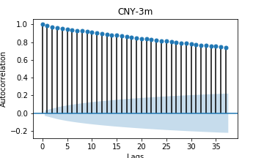
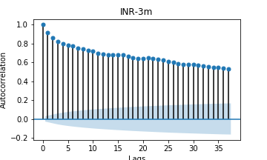
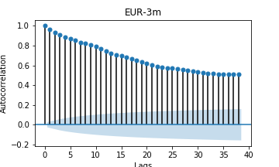
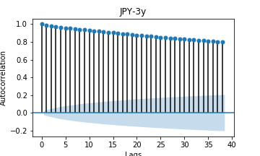
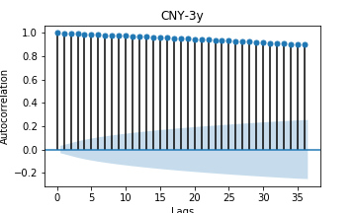
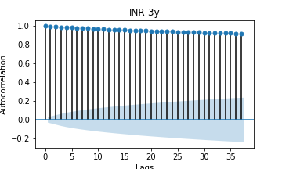
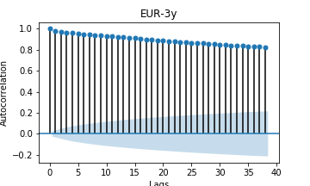
Persistence of basis autocorrelations
Autocorrelations for all currencies show a decaying behavior.
We observe higher persistence for EME as compared to G10
We observe higher persistence for longer tenor(3y) as compared with the shorter tenor (3m)
Deviations for all currencies and tenors are statistically stationary except INR – 3yr and CNY - 3yr

Slide 11
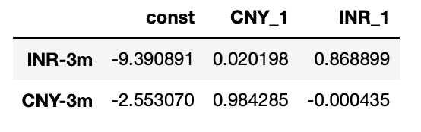
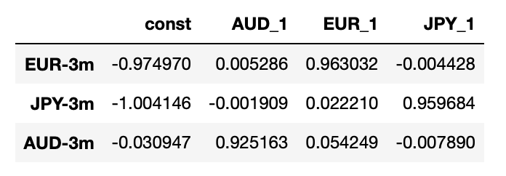
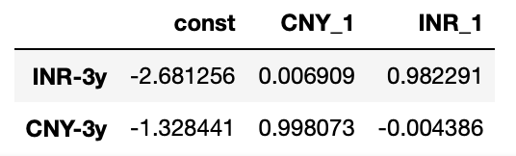
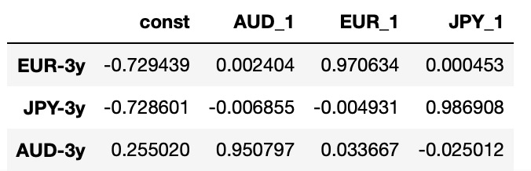
Causal Effects
We use vector autoregressive models to measure the causal effects of G10 and EME currencies.
We observe more causality for smaller tenors (3m)
Causality is more prominent for EME currencies
AUD and EUR have negative causal effect on JPY
INR has negative causal effect on CNY while CNY has positive effect on INR

Slide 12
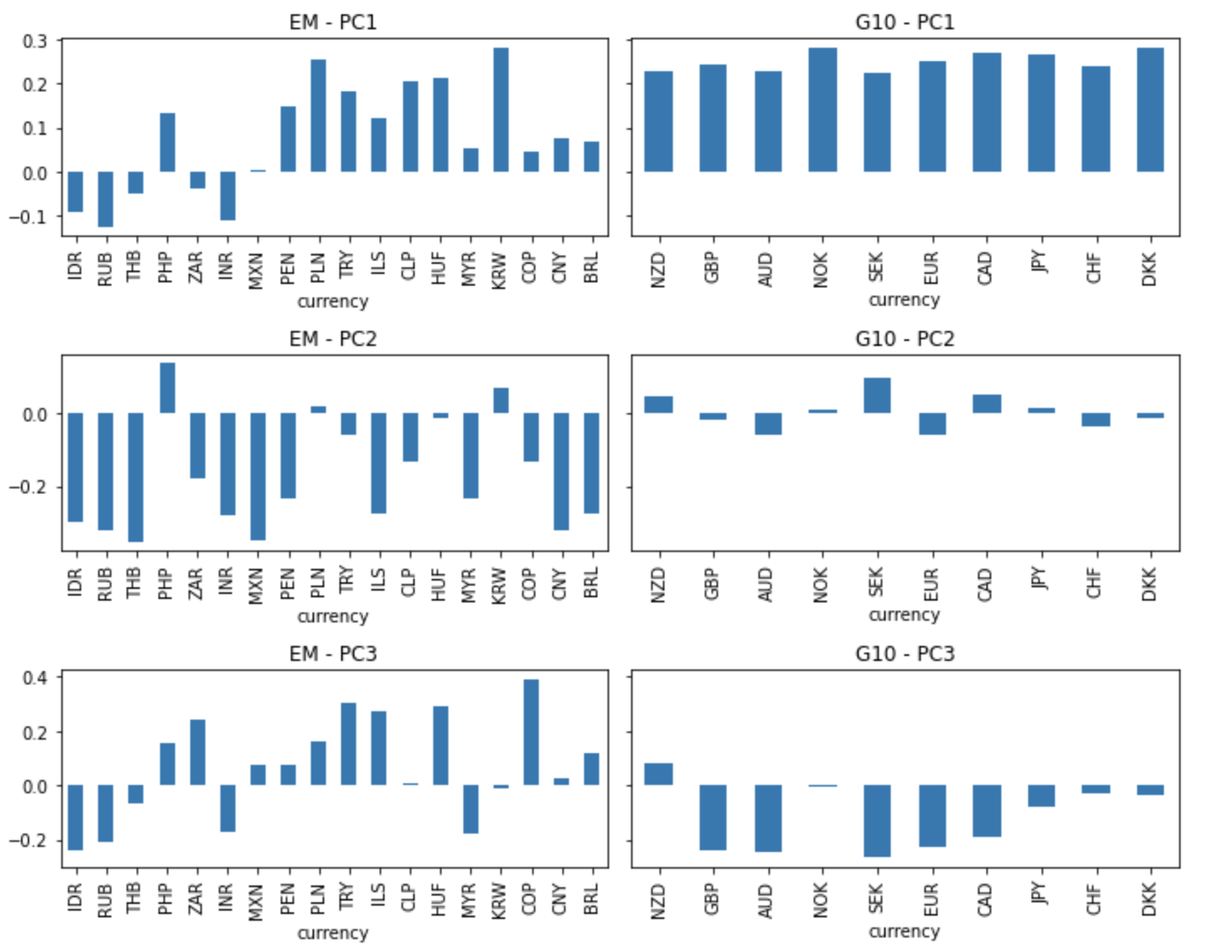
PCA – Short Term (3 month) CIP
The variance explained by the first three factors are: PC1: 38% - PC2: 16% - PC3: 9%
PC1 has strong and roughly equal weights on the G10 countries but much varied, smaller and even negative weights on EM countries
PC2 is has very low loadings on G10 countries while EM countries have strong negative loadings in general

Slide 13
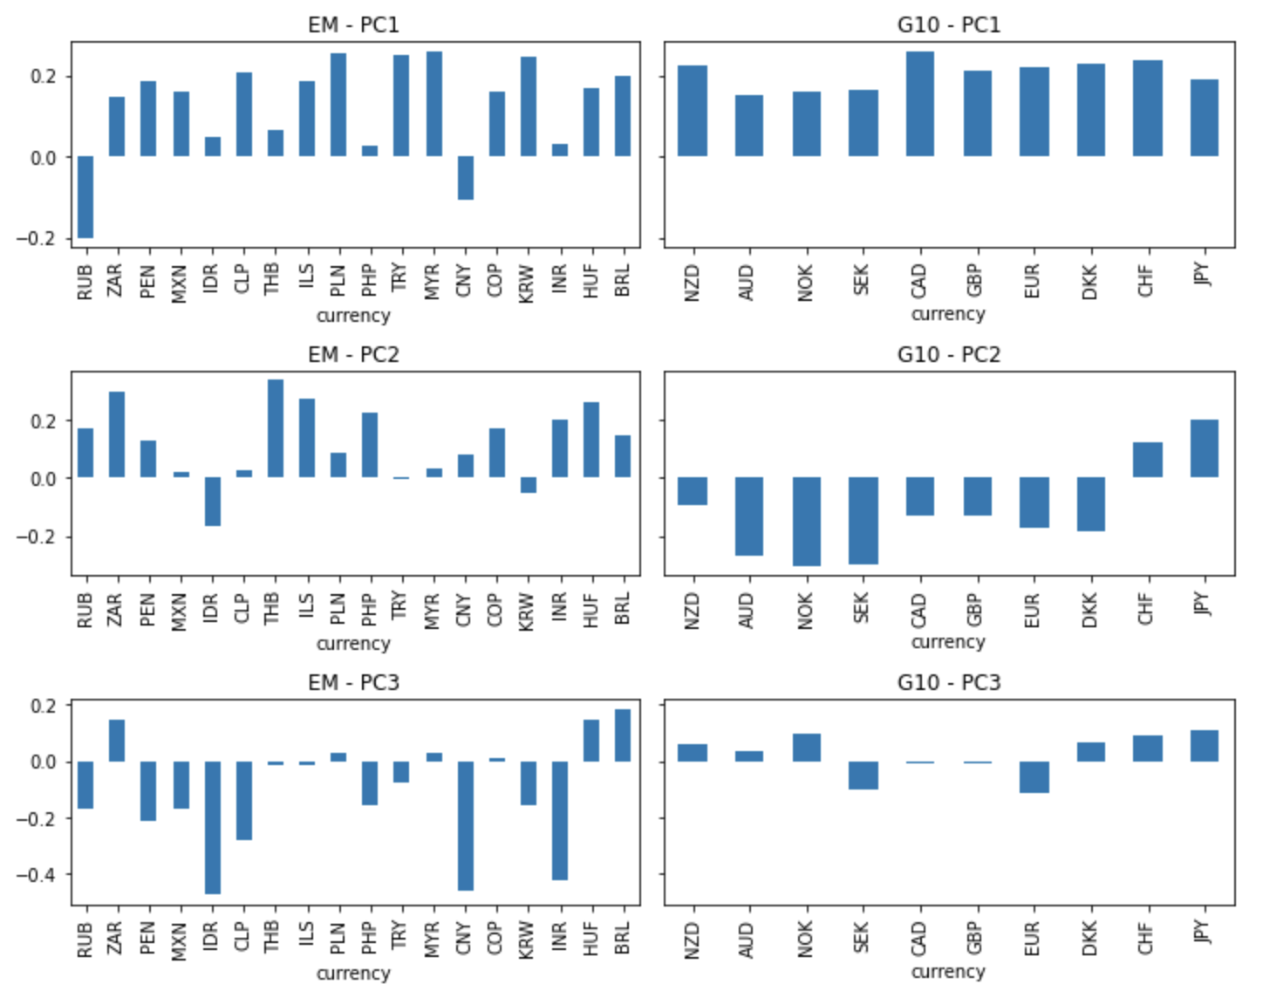
PCA – Long Term (5 year) CIP
The variance explained by the first three factors are a little higher in this case: PC1: 44% - PC2: 22% - PC3 – 10%, PC4 – 5%
PC1 has almost equal weights on the for all G10 and EM countries
RUB and CNY are notable exception in EM markets
PC2 is has negative loadings on most EM countries and generally positive loadings on G10 countries
The anomalous behavior of (RUB, CNY) and (JPY, CHF) might be due to them being the top countries in terms of forex reserves
A 4-factor risk management framework can be optimal in explaining the 80% variance in a multi-currency cross currency swap portfolio.

Slide 14
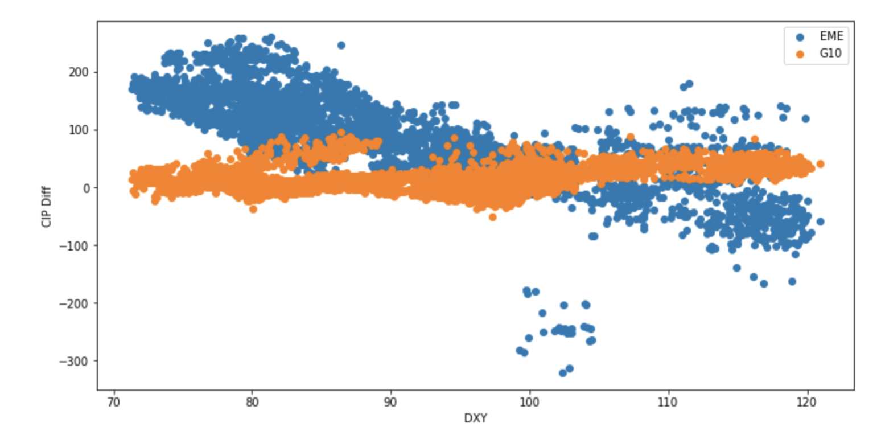
DXY vs xccy basis: Empirical observations
The U.S. Dollar Index (DXY) is a measure of the value of the US dollar relative to a basket of foreign currencies
The plot shows relation between average CIP and DXY for EM and G10 separately
Emerging markets have negative correlation with DXY
CIP violations decrease (increase) when dollar valuation increases (decreases)
The G10 countries are mostly flat but slightly positively sloped

Slide 15
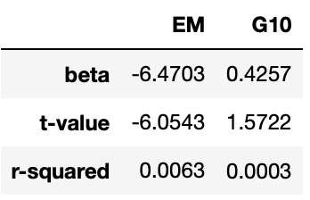
DXY: Regression
Here we regressed the changes in mean CIP of EM and G10 (5y tenor) against the changes in DXY
We can see that the EM countries BRL, CNY and INR have very significant negative relation
For G10 countries the relation is positive but not significant
For both the regression the explained variance is extremely low

Slide 16
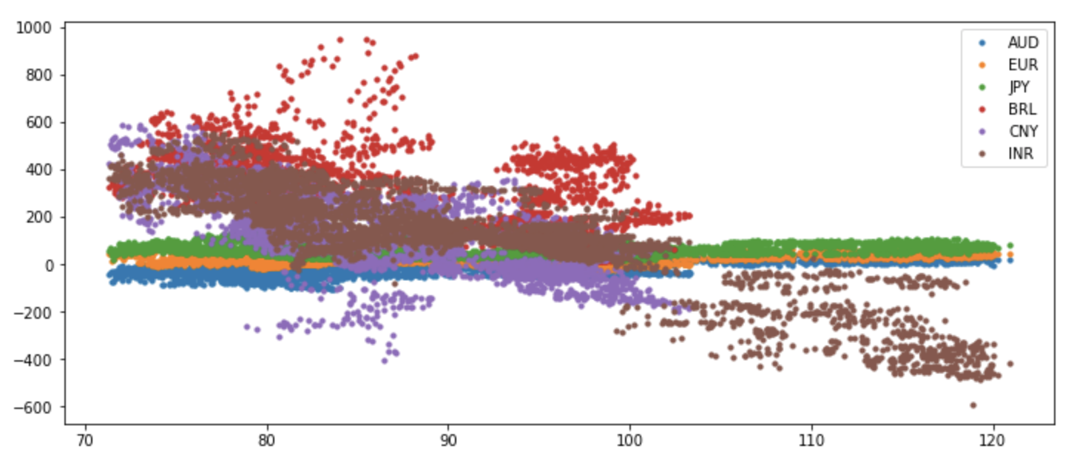
DXY: Country-wise Effects
AUD, EUR, JPY are hardly affected when value of dollar relative to other currencies change
On the other hand emerging market currencies show a general negative trend with relative dollar value
This shows that relative dollar demand affects the CIP value for the EM countries
CIP
DXY

Slide 17
CIP violations and Financial Market Crises
Large CIP deviations historically seen as reflections of global market strains
Spikes observed during the GFC (2008) and the Euro Sovereign Debt crisis (2011-2012) attributed to:
Heightened Counterparty risk concerns
Constrained access to wholesale dollar funding
This can be observed from the trends in the currency basis and the 3m Ted-spread (indicative of counterparty risk) during the two periods of crisis

Slide 18
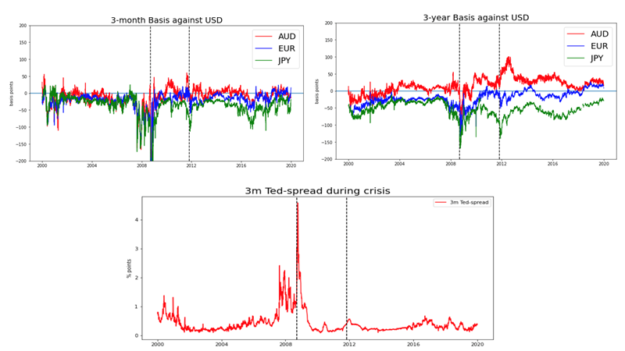
CIP deviations and Financial Market Crisis

Slide 19
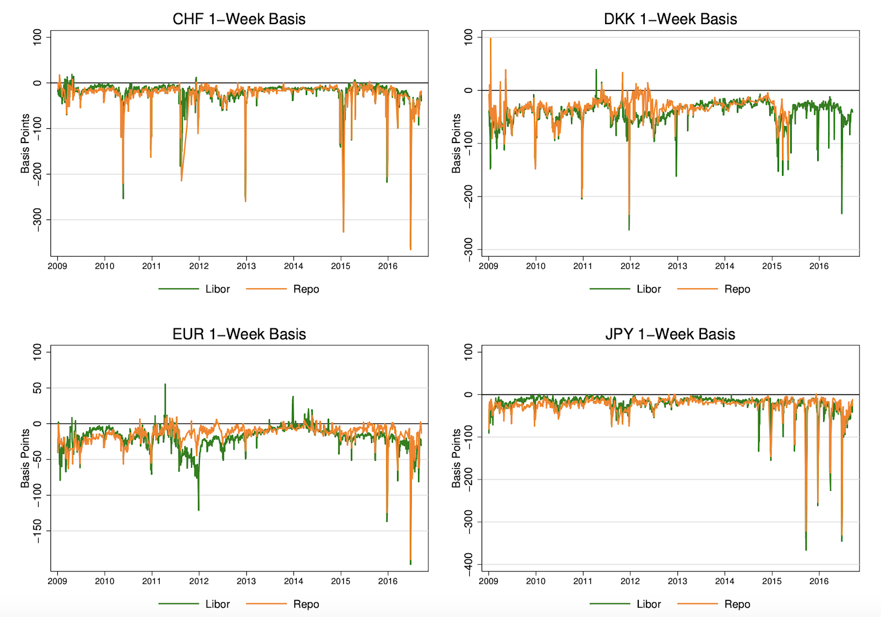
One-week repo and Libor-based CIP deviations
Clearly, CIP deviations exist even for interest rates that are free of credit risk.
Most of the time, the Libor and repo-based deviations are un-distinguishable from each other.
Source: Deviations from Covered Interest Rate Parity (Wenxin Du, Alexander Tepper, Adrien Verdelhan)

Slide 20
Why does CIP deviation exist?
Persistence of xccy basis in post-crisis' periods indicate further factors at play
Demand for dollar hedges in the FX interbank markets that is largely insensitive to the size of the basis
Major players include banks, institutional investors, US corporate bond issues in foreign currencies (reverse Yankee, Samurai bonds etc.)
CIP Arbitrage trades also impose cost to bank's balance sheet
In absence of regulations, costs pertaining to credit/counterparty, market and liquidity risk were negligible as the net open positions on the FX swap is zero
The parity violations are negligible and requires significant leverage for a profitable trading opportunity
Increased cost for arbitrage trades coming from post-crisis leverage and capital requirements for off-balance sheet FX swaps leads to sustained parity violations

Slide 21
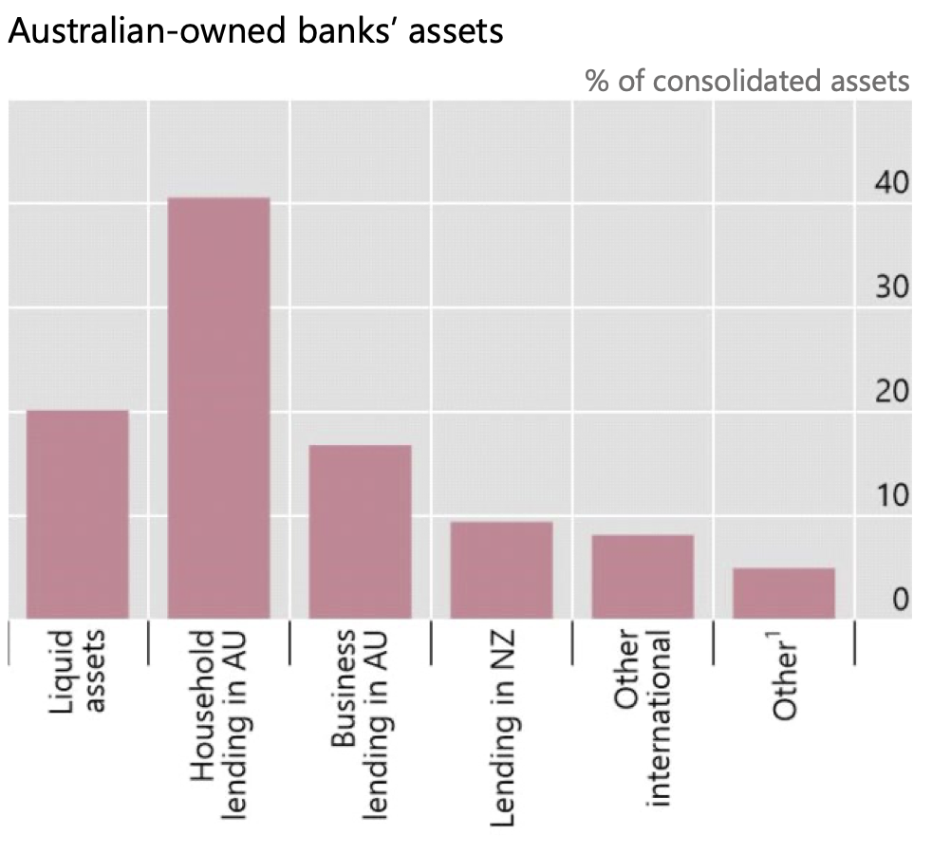
Curious case for AUD!
Major driver for net dollar demand and, thus, basis has been the demand from banks generated from net on-balance sheet USD assets
Australian banks on balance supply US dollars in the cross-currency swap market. That contrasts with banking systems that are funding net US dollar assets and so, on balance, demand US dollars in the swap market.

Slide 22
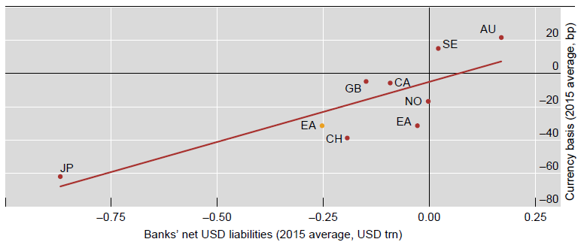
Curious case for AUD!

Slide 23
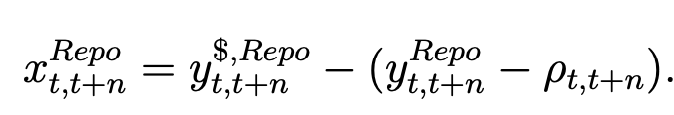
CIP-Based Arbitrage Opportunities
We analyze an investment strategy based on general collateral (GC) repo rates:
At short maturities, one way to eliminate credit risk associated with Libor-based CIP is to use secured borrowing and lending rates from the repo markets.
Given the US dollar GC repo rate, and the foreign currency GC repo rate, the repo basis is defined as:
The results of this strategy are taken from the paper 'Deviations from Covered Interest Rate Parity (Wenxin Du, Alexander Tepper, Adrien Verdelhan)'.

Slide 24
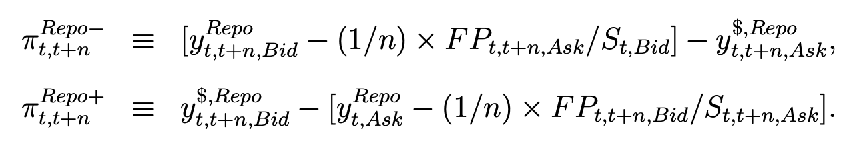
Negative and Positive basis arbitrage
Negative and positive basis:
A negative basis entices the arbitrageur to borrow at the US dollar GC repo rate and invest in the foreign currency repo rate, while paying a forward premium to hedge the foreign currency exposure:
The arbitrage profits under the negative and positive arbitrage strategies are:
Transaction costs:
It is assumed that transaction costs for each step of the arbitrage strategy are equal to one half of the posted bid-ask spread.

Slide 25
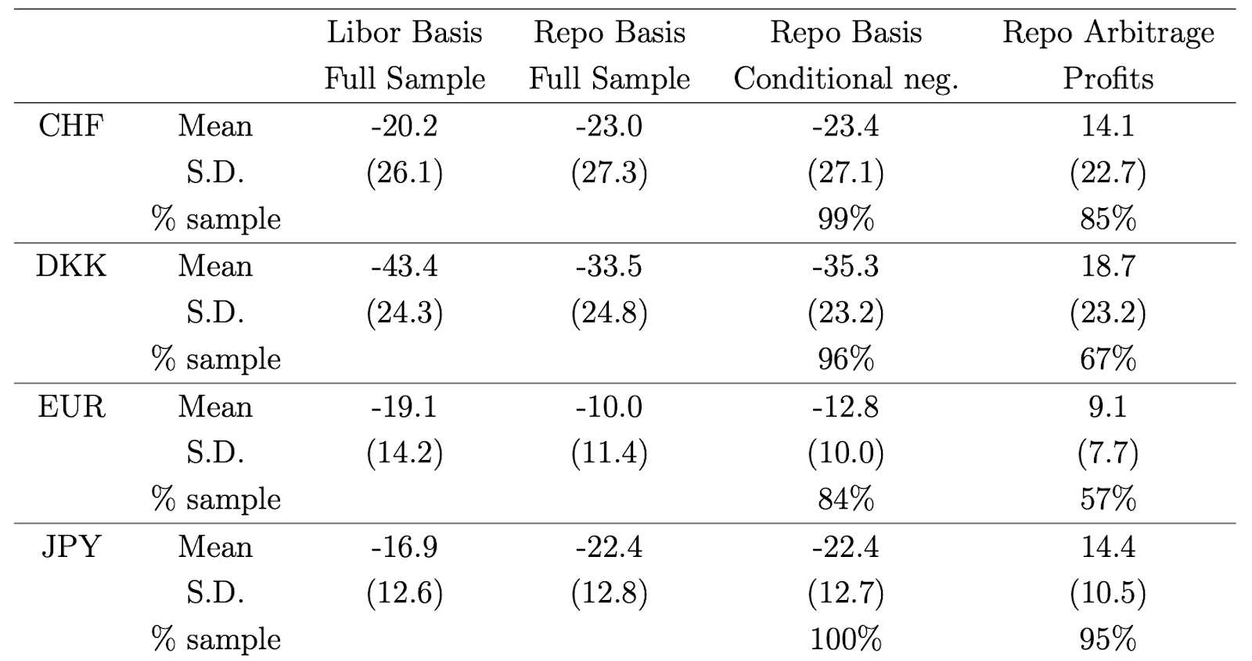
One-week repo and Libor cross-currency basis
Arbitrage profits for the negative basis repo arbitrage after considering transaction costs on forward and spot exchange rates.
Source: Deviations from Covered Interest Rate Parity (Wenxin Du, Alexander Tepper, Adrien Verdelhan)

Slide 26
Banks’ Balance Sheet Costs
Non-risk weighted Capital Requirement - The Leverage Ratio:
Requirement for banks to hold a minimum amount of capital against all on-balance-sheet assets and off-balance-sheet exposure, regardless of risk.
Under Basel III, the ratio became more stringent after the crisis with the introduction of the supplementary leverage ratio.
The arbitrage opportunities on the CIP basis may not be attractive enough for banks, given their overall objective in terms of rates of return on capital. Banks may limit or even shy away from this activity.

Slide 27
Banks’ Balance Sheet Costs
Risk-weighted Capital requirements:
Since one-week arbitrage opportunities exhibit zero VaR, constraints about RWA only matter for long-term arbitrages.
While the RWA is likely to be very small for short-term CIP arbitrage, it appears to be a significant concern for long-term CIP arbitrages.
Capital charges against the 5-year CIP trade increase dramatically from less than 0.4% before the crisis to more than 4% of the trade notional after Basel III went into effect.
Banks engaging in CIP arbitrages could trade a volume equal to 250 times their equity before the crisis; now they can only trade a volume equal to 25 times their equity.

Slide 28
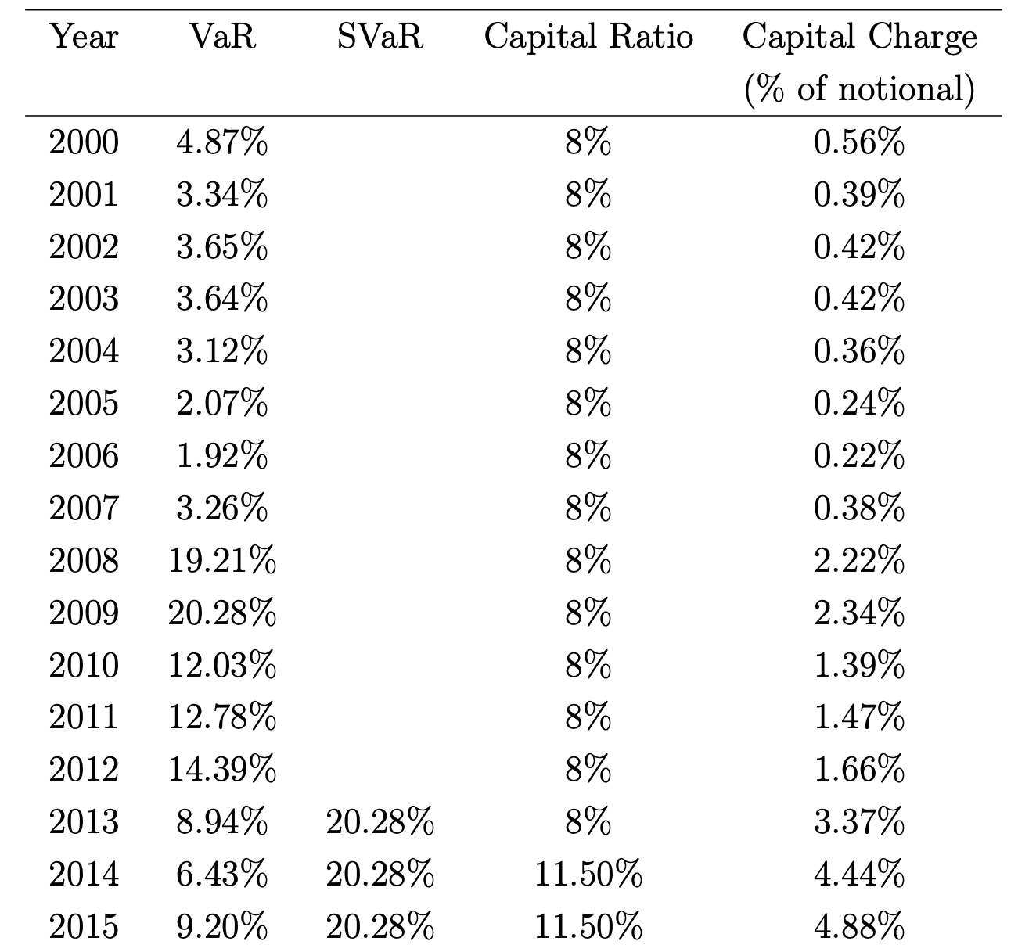
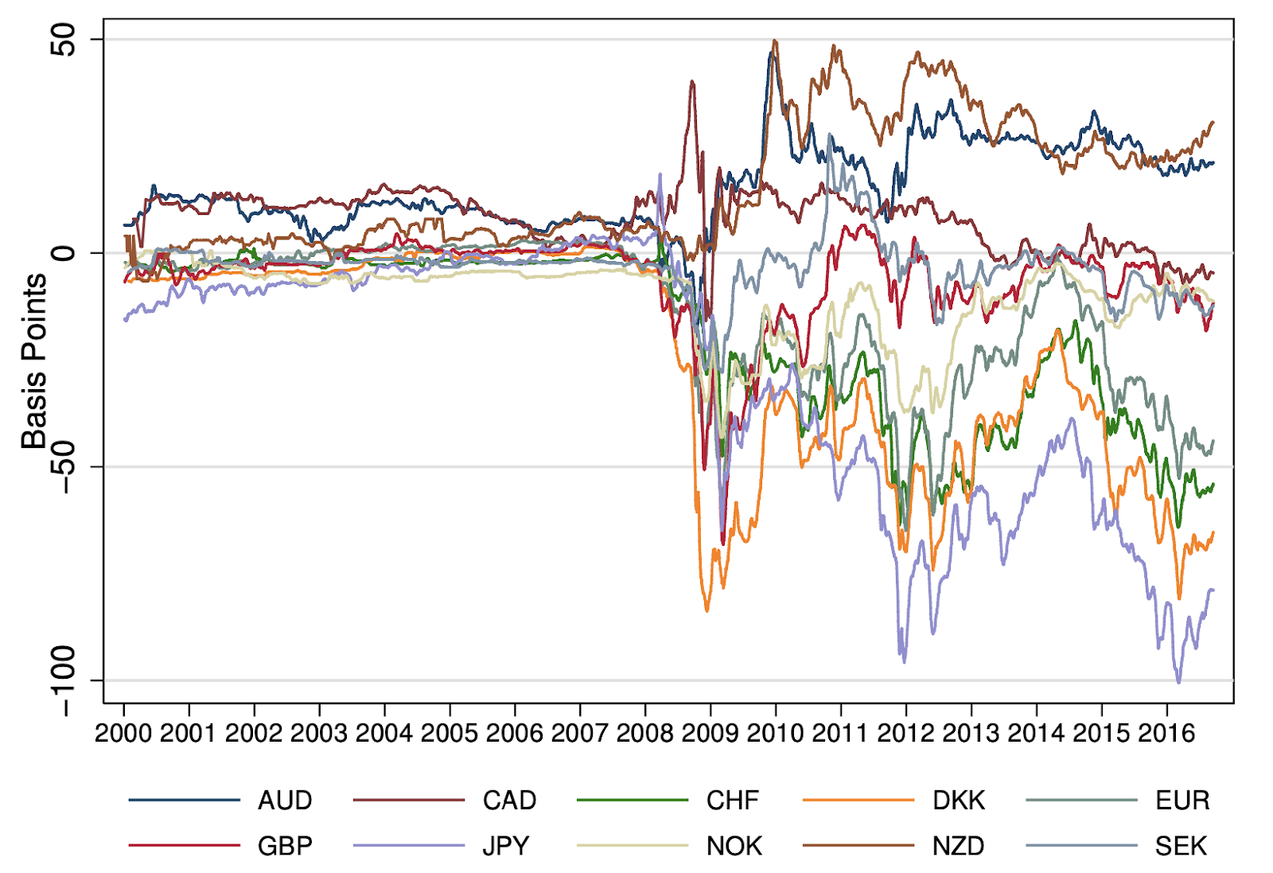
US banks’ capital charges against a five-year Libor CIP trade
US banks' capital charges against a 5-year Libor CIP trade
Long-term Libor based deviations from CIP – 10 day MAs
Banks engaging in CIP arbitrages could trade a volume equal to x250 their equity before the crisis, now they can trade only a volume of x25 their equity.

Slide 29
References
Deviations from covered interest rate parity, Wenxin Du, Alexander Tepper, Adrien Verdelhan (https://www.nber.org/papers/w23170.pdf)
Covered Interest Rate Parity Deviations Between Government Bonds, Wenxin Du, Joanne Im, and Jesse Schreger (https://sites.google.com/site/wenxindu/data/govt-cip?authuser=0)
CGFS Papers No 65 US dollar funding: an international perspective (https://www.bis.org/publ/cgfs65.pdf)
BIS international banking statistics and debt securities statistics (https://www.bis.org/publ/qtrpdf/r_qt1609e.pdf)

